Slide 1
Good DX Good Luck in the Contest! http://groups.yahoo.com/group/adxa/
18 Mar 2017

Slide 2
Reverse Beacon Network
NCDXA/IARU Beacon System
What Does it Do?
How Does it Work?
Why do I Care?
How Can I Use It?

Slide 3
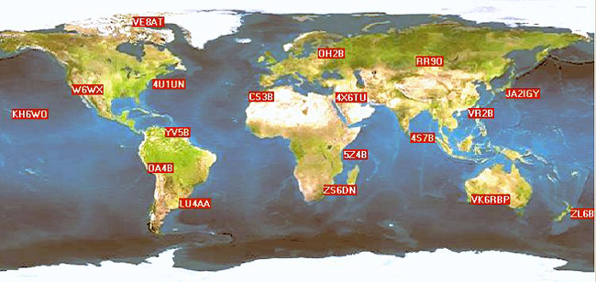
NCDXA/IARU Beacon System
14.100, 18.110, 21.150, 24.930, and 28.200 MHz
Is the band dead? (note—no WARC Bands!)
Band Open to These Locations?
Is It Worth Calling CQ?
Open to Specific QTH?
Notes:
This is pretty handy, but:
Wouldn’t it be great to know how well you’re getting out without spending hours testing your antenna on various bands?
How about comparing antennas on the same band?
How about looking for rare DX stations?
The RBN can help you do these things, and more!

Slide 4
NCDXA/IARU Beacon System
Handy for Quick Propagation Check But,
Where Are You Heard?
How Well do Your Antennas Work?
Compare Your Antennas in Real Time?
Looking for Specific DX Stations?
Notes:
The RBN can help you do these things, and more!

Slide 5
RBN—What?
Network of World-Wide Stations
Listening to Entire (CW/RTTY) Bands
Reports What They Hear When & How Well
Near Real Time Spots
Presented in Spot Search, Data, or Map
RBN & Beacons for Propagation Study
Notes:
Use a “local” RBN station with NCDXF/IARU beacons.

Slide 6
Active Stations 16 Mar/1700 UTC
3B8CW - | DL9GTB | JA1LZR | LA6TPA | PR1T | W1NT
7K1NUY - | DQ8Z | JA4ZRK | LB5WB | PY1FR | W2AXR
7L4IOU - | E28AC | JF1WNY | LZ4UX | PY1KN | W2LB
7N4XCV | EA5WU | JF2IWL | LZ7AA | R0BB | W2NAF
9M2CNC | EA6VQ | JJ2VLY | M0VSE | RN4WA | W2UTH
A45WG | EC1CT | JS1JRZ | N2QT | RU9CZD | W3CP
AA4VV | ES5PC | K1TTT | N4ZR | RX3AFE | W3LPL
AC0G | ET3AA | K2MFF-2 | N6EV | S50ARX | W3OA
BD2FW | F4KJI | K2MFF-3 | N6TV | SE0X | W3UA
BH4RRG | F5RRS | K2PO | N7TR | SK3W\ | W4AX
CX7ACH | F6IIT | K3PA | N7TUG | SM2IUF | W4KAZ
DB0MMO | G0LUJ | K6XT | N9YKE | SM6FMB | W4KKN
DF1LON | G0TTV | K8ND | NC7J | SV1DPJ | W7HR
DF4UE | GI4DOH | K9IMM | NH6HI | SV3EXP | W8WTS
DF4XX | GW8IZR | K9TM | NO1D | SV8RV | W8WWV
DF7GB | HA1VHF | KB7IJ | NY3A | TF3Y | WA2ZYU
DJ3AK | HA2KSD | KC0VKN | OE6TZE | UA4M | WA7LNW
DK0TE | HA6PX | KH6LC | OG6G | V31HQ | WA9VEE
DK3UA | HB9BXE | KL7RA | OH6BG | VE2WU | WB6BEE
DK8NE | HB9DCO | KO7SS | OK1IAK | VE6AO | WE9V
DK9IP | HB9JCB | KP3Z | ON5KQ | VE6JY | WZ7I
DL0LBS | HK6F | KQ8M | ON6ZQ | VE6WZ | ZL1AB
DL4RCK | I2DMI | KS4XQ | OZ5W | VK4CT | ZL2HAM
DL6ZB | IK3STG | KU7T | PA0MBO | VU2PTT | ZL2RV
DL8LAS | JA1JRS | LA5EKA | PJ2A | W0MU
List of Active Stations On-Line Reporting Spots
to RBN 16 Mar
At 1700 UTC
AF
OC

Slide 7
Skimmers’ Statistics 16 Mar
we have 150 skimmers online now
we have had 4 new skimmers in the last 7 days
we have had 152 skimmers online in the last hour
we have had 166 skimmers online the last 24 hours
we have had 203 skimmers online the last 7 days
we have had 1890 skimmers online since we begin

Slide 8
Active Stations’ Bands Reported
7N4XCV - 40m
9M2CNC - 40m,20m,30m
A45WG - 40m
AA4VV - 20m,15m,17m
AC0G - 20m
BD2FW - 40m
CX7ACH - 12m,15m
DF1LON - 40m,30m,17m,20m
DF4UE - 40m,17m,20m,15m,30m,80m,160m
Notes:
Obviously, this is just a small portion of active skimmers.
Note the differences in bands!

Slide 9
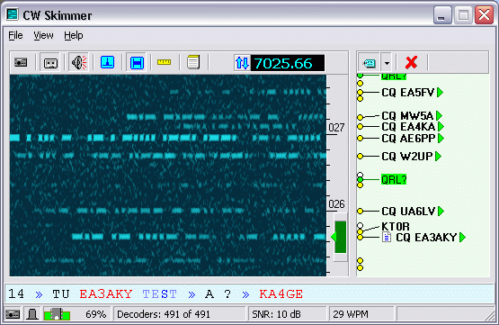
CW Skimmer Decoding

Slide 10
Typical Contest CW Spectrum
ARRL 10M Contest 2015 at K8TE
Notes:
My station during the ARRL DX-CW Contest Feb 2015

Slide 11
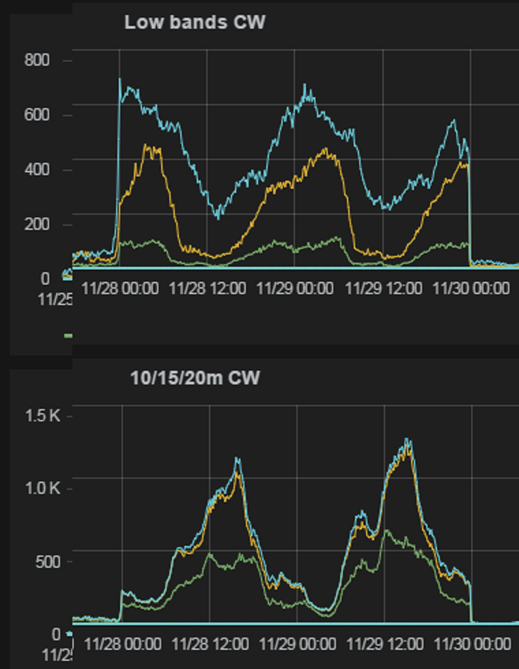
2015 CQ WW CW Stats and Trivia
No Hiccups for the Entire 48 Hours!
Seven Million Spots 7,000,000+!
2.1% Error Rate— Listen First!
Notes:
Low bands pick-up when high bands decline.

Slide 12
Typical Spot List (Condensed!)
de | dx | freq | snr | speed | time
KP3Z | 5U5R | 14024 | 14 dB | 35 wpm | 1857z 16 Mar
K8ND | WX6B | 14035 | 24 dB | 28 wpm | 1857z 16 Mar
W1NT | DJ1KJ | 14013 | 7 dB | 24 wpm | 1857z 16 Mar
W3LPL | ON6PJ | 14029.8 | 3 dB | 24 wpm | 1857z 16 Mar
VE2WU | K0RO | 14050.2 | 11 dB | 14 wpm | 1857z 16 Mar
WZ7I | ON6PJ | 14029.8 | 16 dB | 23 wpm | 1857z 16 Mar
WZ7I | PE2JB | 14048 | 20 dB | 15 wpm | 1857z 16 Mar
TF3Y | 5U5R | 14024 | 5 dB | 35 wpm | 1857z 16 Mar
ON5KQ | W3HGT | 14035.1 | 20 dB | 31 wpm | 1857z 16 Mar
HA6PX | 5U5R | 14024 | 17 dB | 35 wpm | 1857z 16 Mar
K2PO | F6HKA | 14047 | 27 dB | 14 wpm | 1857z 16 Mar
W3LPL | PE2JB | 14048 | 12 dB | 15 wpm | 1857z 16 Mar
KM3T | F6HKA | 14047 | 41 dB | 14 wpm | 1857z 16 Mar
Up to 100 Spots

Slide 13
RBN—What Else?
Database of Past Spots!
Compare Your Signal with Others’
Best Coverage: North America and Europe
CW/RTTY/PSK Only (so far)

Slide 14
RBN Map
16 Mar
Only Most Current Spots
Notes:
Other Sites show more spots since they include SSB

Slide 15
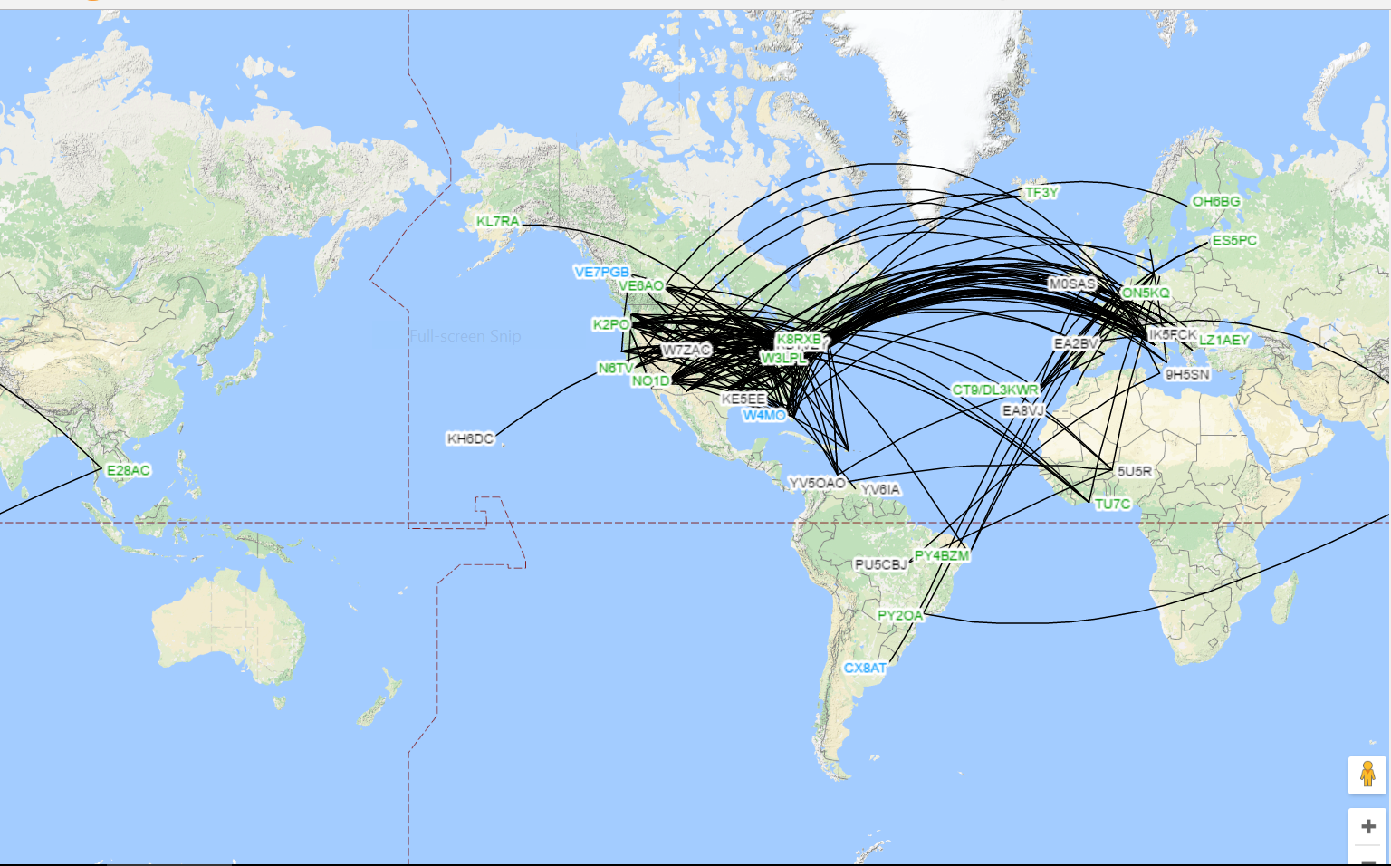
DXMaps.com 20m 16 Mar
Also
Station Lists
Bandmap Graphic
Select by Band/Group
All Spotted Modes

Slide 16
RBN—Why in My Station?
Is there a station I need to work operating now?
Am I likely to hear and work it?
What is his frequency?
What is his CW speed? (NO SSB!)
When should I get on the air to work him?
How does my signal compare with…?
Work more DX!
Make More Contacts (Contesting)!
Do I need to make station changes?

Slide 17
RBN—When to Work Him?
Any DX Spotting Works for Right Now
RBN Provides Historical Data for Future Contacts
Combine with VOACAP for Highest Probabilities
KO7SS on Mt. Lemmon 15 Mar:
Notes:
Little point chasing DX when they’re sleeping!

Slide 18
5U5R—Niger
30m Best
0000 UTC
0100 MDT
6% Probability
Possible—Maybe

Slide 19
15 Mar RBN Data Elements
callsign
de_pfx
de_cont
freq
band
dx
dx_pfx
dx_cont
mode
db
date
speed
tx_mode

Slide 20
15 Mar RBN Data for 5U5R
2,273 Reports
All Continents But Antarctica Reported
KO7SS Reported 27 dB on 7003 at 0153 UTC
Very Copyable Signal at a Quiet Location
Tucson “Near” Albuquerque
Reasonable Expectation to Work Them

Slide 21
RBN—How in My Station?
Chasing DX with Spots
Data Dump, Sort, and Analysis
Live Filtering
Biggest Bang for the Buck Antenna Comparisons!

Slide 22
RBN—Antenna Comparisons
Immediate Comparisons
Computer vs. Human Reliability
Multiple Sites Available
24/7 Coverage (With Propagation)
Compare Over Time Time of Day, Time of Month, Seasons
Only Good for Same Moment in Time!
Not Anecdotal!

Slide 23
My signal compared with…?
Choose Month then Date
ZIP’d CSV File
Open in Excel or Equivalent
Sort as Needed
15 Mar 235,910 Lines of Data!

Slide 24
RBN—Antenna Comparisons
Raw Data Comparisons with Other Stations
Compare Against “Locals” In Town, Nearby States, CONUS Regions
Same Times Mean Antennas/Power Levels
Different Times Point to Propagation and Above
Who Is Your “Competition”
NOTE: Most Skimmers at Contest Stations Some at DX Stations Almost All at One or Both

Slide 25
Antenna Comparison Procedure
Have CW Memories/Hand Key or Paddle
Send “RBN TEST DE K8TE K8TE” on Frequency 1
Switch to Next Antenna
Send “RBN TEST DE K8TE K8TE” on Frequency 2
Repeat for 2 or 3 Minutes to Ensure Good Data
Search for Your Call with 100 Spots (Maximum)
Highlight Data
Paste into Excel or Equivalent
Analyze the Data

Slide 26
Antenna Comparison Procedure—K8TE
de | dx | freq | snr | time
W2LB | K8TE | OCF | 15 dB | 1424z 13 Mar
W2LB | K8TE | OCF | 15 dB | 1425z 13 Mar
W2LB | K8TE | OCF | 21 dB | 1425z 13 Mar
W2LB | K8TE | OCF | 22 dB | 1426z 13 Mar
KM3T | K8TE | OCF | 8 dB | 1425z 13 Mar
JS1JRZ | K8TE | OCF | 7 dB | 1425z 13 Mar
NY3A | K8TE | OCF | 13 dB | 1425z 13 Mar
W7HR | K8TE | OCF | 38 dB | 1424z 13 Mar
W7HR | K8TE | OCF | 41 dB | 1425z 13 Mar
W7HR | K8TE | OCF | 42 dB | 1426z 13 Mar
W2LB | K8TE | FAN | 13 dB | 1425z 13 Mar
W2LB | K8TE | FAN | 18 dB | 1425z 13 Mar
W2LB | K8TE | FAN | 13 dB | 1425z 13 Mar
W2LB | K8TE | FAN | 18 dB | 1426z 13 Mar
KO7SS | K8TE | FAN | 31 dB | 1425z 13 Mar
VE2WU | K8TE | FAN | 18 dB | 1425z 13 Mar
K9TM-4 | K8TE | FAN | 6 dB | 1425z 13 Mar
KM3T | K8TE | FAN | 10 dB | 1425z 13 Mar
JE1SGH | K8TE | FAN | 13 dB | 1426z 13 Mar
W7HR | K8TE | FAN | 34 dB | 1424z 13 Mar
W7HR | K8TE | FAN | 42 dB | 1425z 13 Mar
W7HR | K8TE | FAN | 35 dB | 1426z 13 Mar
Sorted by
Date
Time
Re-Sort By
Frequency
Sub Antenna Name
Compare Antennas at Each “de” QTH
Look Up at QRZ
W2LB Farmington NY
KM3T Amherst NH
NY3A Glen Rock PA
W7HR Port Orchard WA
KO7SS Tucson AZ
K9TM Sylvania OH

Slide 27
Antenna Comparison Procedure—K8TE
W2LB Farmington NY
Fan Dipole Lowest dB
OCF Dipole Highest dB
9 dB Highest to Lowest
Highest Within 2 dB
Lowest Within 2 dB
Better Antenna? Like Often, “It Depends!”
W2LB | K8TE | FAN | 13 dB | 1425z 13 Mar
W2LB | K8TE | FAN | 13 dB | 1425z 13 Mar
W2LB | K8TE | FAN | 13 dB | 1442z 15 Mar
W2LB | K8TE | OCF | 15 dB | 1424z 13 Mar
W2LB | K8TE | OCF | 15 dB | 1425z 13 Mar
W2LB | K8TE | FAN | 18 dB | 1425z 13 Mar
W2LB | K8TE | FAN | 18 dB | 1426z 13 Mar
W2LB | K8TE | FAN | 20 dB | 1442z 15 Mar
W2LB | K8TE | OCF | 21 dB | 1425z 13 Mar
W2LB | K8TE | OCF | 22 dB | 1426z 13 Mar
Notes:
Both antennas at 35 ft. in center.
OCF Dipole cut for 80m.
OCF dipole has little droop.
Fan Dipole ends droop about 5 feet.

Slide 28
Antenna Comparison Procedure—K8TE
W7HR |  | FAN | 34 dB | 1424z 13 Mar
W7HR |  | FAN | 35 dB | 1426z 13 Mar
W7HR |  | OCF | 38 dB | 1424z 13 Mar
W7HR |  | OCF | 41 dB | 1425z 13 Mar
W7HR |  | FAN | 42 dB | 1425z 13 Mar
W7HR |  | OCF | 42 dB | 1426z 13 Mar
W7HR Port Orchard WA
Fan Dipole Lowest dB
Both Highest dB
Lowest Within 4 dB
8 dB From Highest and Lowest
So What?
Both Antenna Play Well at 8:25 MDT (Well After Sunrise)
CRITICAL—Be Ready to Switch Antennas Rapidly!
Lowered Dipole Ends Matter! Fan Used to be Better!

Slide 29
RBN—How in My Station?
Everybody Has an Internet Connect—Right?
Go to: http://www.reversebeacon.net
Choose Your “Flavor”
DX/CONUS/Your Station
Have Your Logging Program Ready
Nab Him
Log Him
QSL Him

Slide 30
RBN—Live Filtering
Notes:
Similar to DXWatch and other DX Spots sites.

Slide 31
Summary
NCDXA/IARU Beacon System
What Does it Do?
How Does it Work?
Why do I Care?
How Can I Use It?
Standby for K8TE Skimmer on RBN—2017 I Hope!
Questions?

